Slide 1
Voter Registration & Outreach
Santa Cruz County Clerk/Elections presents
Promote the vote for the November 3, 2020 Presidential General Election

Slide 2
Introductions & Welcome
County Clerk Gail Pellerin
Program Coordinator Helen Ruiz-Thomas

Slide 3
Ballots will be mailed to all voters in California to promote safe voting from home
Ballots will be mailed on October 5, 2020.

Slide 4
Legislative Update – Executive orders and Legislation
Pursuant to Governor Newsom’s Executive Orders N-64-20 signed on May 8 and N-67-20 signed June 3, elections officials will mail ballots to all voters in the State of California.
Mailing ballots to all voters is intended to preserve public health due to COVID-19, and to ensure that the November election is accessible, secure and safe for all Californians who will have the option to vote from the safety of their own homes.
In-person voting options will also be provided: 1/10k voters. 2 locations will be open for 29 days. An additional 15 will be open for 4 days.
SB 423 (Umberg) – In committee.
Makes changes to in-person voting requirements. Requires voter outreach to be in all languages required in the county. Provides a process for counties to waive or modify requirements.
AB 860 (Berman) – Signed into law.
Expands RAVBM to all voters. Requires use of BallotTrax for voters to track their ballot incoming and outgoing. Expands postmark deadline from E-3 to E-17 (Nov. 20). Allows counties to start to process VBMs when we get them.
4

Slide 5
A look back at March 3, 2020…

Slide 6
March numbers
Registered voters: 163,526
Total votes cast: 103,900
Votes cast at the polls: 33,222
Votes cast by mail ballot: 70,678
Turnout = 63.56%... Or what I call a D grade!
Number of mail ballot requests: 121,579
Number of mail ballots challenged: 852
Too late: 632
No signature: 108 (77 were cured)
Sig didn’t compare: 95 (35 were cured)
Empty envelope: 14
Two ballots in one envelope: 1
Number of Same Day Registration voters: 3,086
Number counted: 2,935
Number of Provisional ballots cast: 2,802
Number counted: 2,774

Slide 7
Ballot returns for the full 29 days + 3

Slide 8
We need to work together to flatten the voting curve!

Slide 9
Key dates and deadlines
July 13 – August 7: Candidate filing. If the incumbent does not file, filing is extended to August 12.
August 7: Last day to call an election
August 13: Random Alpha – SOS alpha will determine order of local contests. County random will determine order of State Senate and State Assembly.
August 14: Arguments & Analyses Due
August 21: Rebuttals Due
September 4: Military and Overseas ballots go out - RAVBM
October 5: First day to mail ballots. Current VR = 166,663
October 19: Last day to register to vote – may be extended
October 31 – November 3: Voter service centers open
9am to 5pm on Saturday and Sunday
8am to 5pm on Monday
7am to 8pm on Tuesday
November 29: Deadline to cure a missing or non-comparing signature
November 30: Deadline to declare those elected to school and special districts. Conflicts with the other deadlines to certify the election.
December 1: Deadline to certify presidential contest. Dec. 3 for all others.

Slide 10
What’s on the ballot in November
Nominees for:
President & Vice President
Congress
State Senate
State Assembly
Superior Court Judge
County Supervisor, 1st District
And
City Councils: Capitola (2); Santa Cruz (4), Scotts Valley (3), Watsonville (Districts 1, 2 & 6)
2 County Boards of Education/2 Community College Boards
6 Unified School Districts
8 Elementary School Districts
9 or 10 Fire Districts (Central and Aptos may merge)
5 Water Districts
Port District
2 Recreation Districts

Slide 11
Our ballots will be mailed with a hug & a kiss! BallotTrax to track your ballot!

Slide 12
How to return your ballot after voting from home.
Voters may return their ballot in one of the following ways:
Drop it off at one of our 24-hour drop boxes
Aptos - Cabrillo College Parking lot R by the stadium
Aptos – Public Library, 7695 Soquel Dr
Aptos - Polo Grounds near the dog park, 2255 Huntington Dr
Ben Lomond - Highlands Park, 8500 Highway 9
Capitola – 420 Capitola Ave in the City Hall parking lot
Felton - Covered Bridge Park at Mt. Hermon and Graham Hill Rd
Santa Cruz - 701 Ocean St in front of the County Government Center
Santa Cruz – 212 Church St in the public parking lot
Scotts Valley – 1 Civic Center Dr in the City Hall parking lot
Watsonville – 316 Rodriguez St in the municipal public parking lot 14
Watsonville – 1432 Freedom Blvd parking lot
UCSC Quarry Plaza
We will add two more drive-up drop off boxes for November.
Return it in person before and including Election Day at the County Elections Office or any of the City Clerks’ Offices.
Return it to a voter service center open Saturday, Oct. 31 to Tuesday, Nov. 3.
Mail it so it is received on time – ballots postmarked on or before Election Day and received by November 20, 17 days after the election, will be considered received on time.

Slide 13
In-Person voting locations will be available for voters to do the following:
Return a voted ballot
Obtain a second ballot
Vote on the accessible tablet
Vote a Spanish ballot on the tablet
Register and vote on the same day
Vote provisionally
Any other voting service
13

Slide 14
Voter Service Center locations used in March 2020
Santa Cruz County Clerk/Elections Office
Watsonville City Clerk’s Office
Simpkins Family Swim Center
Capitola City Hall
Community Foundation
Pajaro Valley Community Conference Room
UCSC – Bay Tree Conference Center
Scotts Valley Skypark
Zayante Fire Station
Ag Extension/Behavioral Health

Slide 15
Possible locations to add in November. We need 7 more locations to meet ratio of 1/10k voters
Resurrection Church
Felton Library
Twin Lakes Church
Loma Prieta Community Center
Highlands Park
Other ideas?

Slide 16
Election Worker Training
We will most likely have online training and some in-person training.
16

Slide 17
Recruiting election workers
250 people to staff the voter service centers
28 to clear ballot drop boxes
50 to staff voter hotline
50 for Election Night returns
17
This Photo by Unknown Author is licensed under CC BY-SA-NC

Slide 18
How to contact voters safely. Advice from Dr. Gail Newel, Santa Cruz County Health Officer
It is hard to get COVID-19 from inanimate objects.
The biggest risk lies with close contact with other people. Close contact is defined as within six feet for more than 10 minutes, regardless of face coverings.
As case rates continue to increase, it is more important than ever to follow the social distancing requirements, which include:
Wearing a face covering while engaging with others at work or in public;
Keeping a six-foot distance from persons who are not members of your household;
Frequently washing hands with soap and water for at least 20 seconds;
Covering coughs or sneezes with tissue or fabric, or using your elbow; and
Staying home if you are sick with a fever or cough.
People are encouraged to contact voters in an outdoor public setting where they can stand more than six feet away.

Slide 19
Voter outreach efforts
Assisted living facilities
Hospitals
Jails and inmate facilities
UCSC – voters who are here and studying remotely & Cabrillo
High School voter education
Voters with disabilities
Spanish-speaking voters, other languages?

Slide 20
Events? Will there be any?
Start of Cabrillo College – August 24
High School Voter Registration Weeks – last two weeks of September
Any other events?
National Voter Registration Day – September 22
UCSC move in day – September 25-27

Slide 21
How to Promote the Vote!
Social Media
Trusted messengers
Precinct captains
YouTube Videos
Zoom Town Halls
Honor veterans. Vote.
Democracy at work
Other ideas?

Slide 22
Be an informed voter. It’s 3 easy steps.
Sign up
Sign up! www.registertovote.ca.gov
Check up
Check up! VoterStatus.sos.ca.gov
Track it
Track it! WheresMyBallot.sos.ca.gov

Slide 23
Social media examples

Slide 24
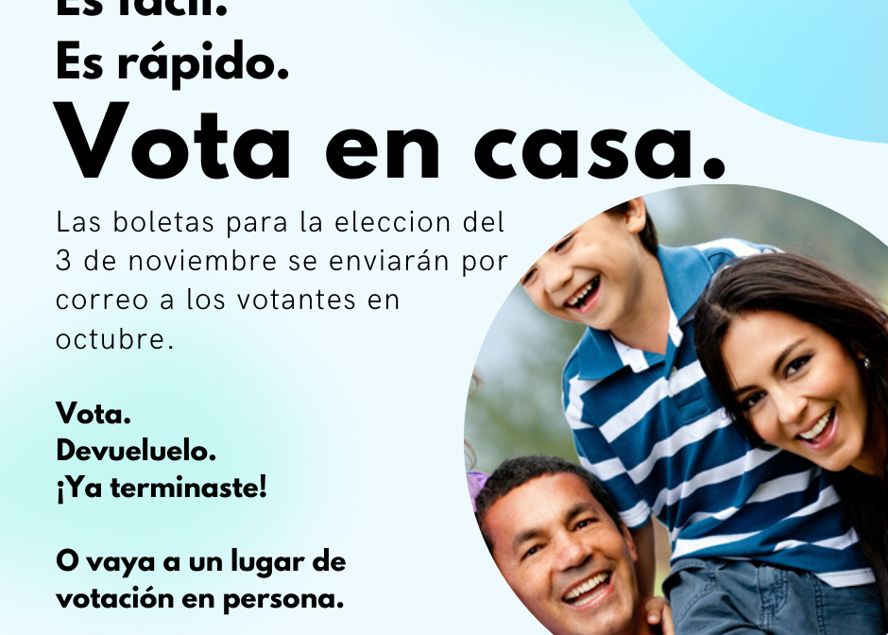
More examples
We use Canva, a free online graphics program to create these posts.

Slide 25
Sample flyer.

Slide 26
Thank you!
Gail Pellerin Santa Cruz County Clerk 831-454-2419 gail.pellerin@santacruzcounty.us
Helen Ruiz-Thomas Voter Outreach Program Coordinator 831-454-3389 helen.ruiz-thomas@santacruzcounty.us

